Slide 1

Tariq Baghrous
Tommaso Farneti
Business Intelligence Homework
Data Science - Year 2023/24

Slide 2
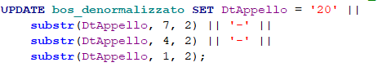
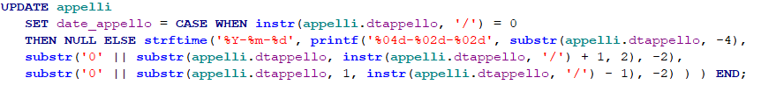
Preprocessing
In preparation for analysis, the date format in the database was proactively adjusted to align with the supported format for SQLite functions.
Relational model
bos_denormalizzato
1 - Added a new column of the 'datetime' type
1 - Changed the date format of the 'dtappello' column
2 - Updated the new column with the correct dates

Slide 3
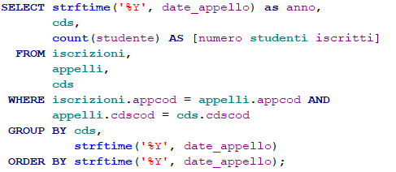
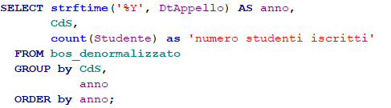
Query 1
Distribution of the number of students enrolled in various exam sessions, broken down by year and degree program.
Relational model
bos_denormalizzato

Slide 4
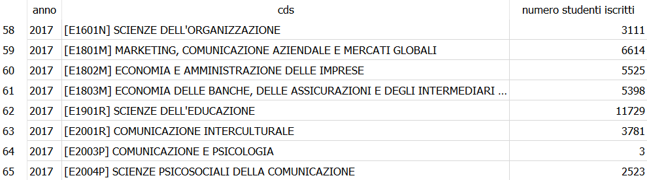
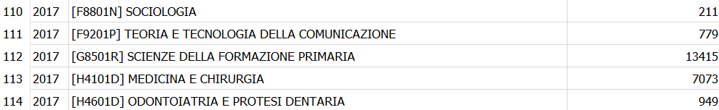
Query 1
Distribution of the number of students enrolled in various exam sessions, broken down by year and degree program.
Output
The total number of courses retrieved is 123
The enrolment timeframe detected is 2016 - 2017, due to lack of data for 2015 and 2018
Course of studies with the most number of students enrolled in various exam sessions are “Scienze della Formazione Primaria” followed by “Scienze dell’Educazione”
...

Slide 5
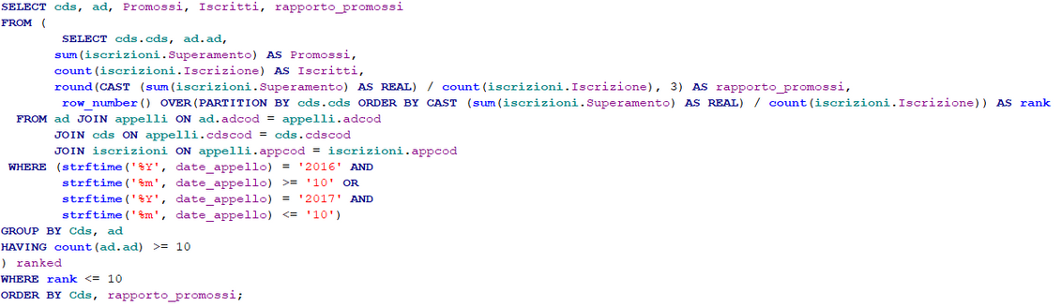
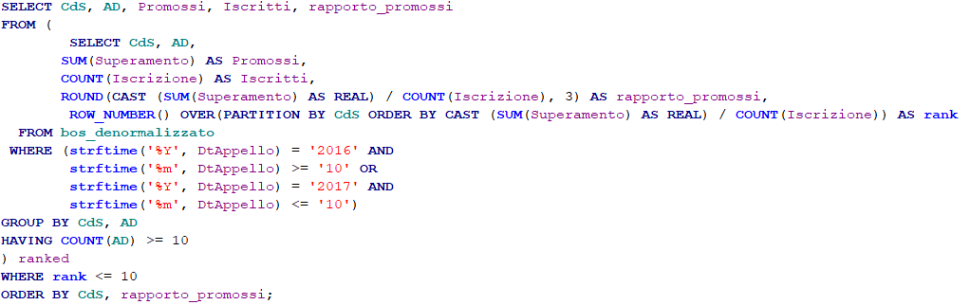
Query 2
Identification of the Top-10 most difficult exams, divided by field of study (the exam with the highest overall pass rate, considering all sessions of the Academic Year).
Relational model
bos_denormalizzato
We selected the academic year 2016/17 (from October 2016 to October 2017).
We considered only those course of studies with at least 10 educational activities.
rapporto_promossi is determined by the ratio of the number of students who passed the exam to the number of students who registered for the exam.
CAST ensures that the division occurs between floating-point numbers.

Slide 6
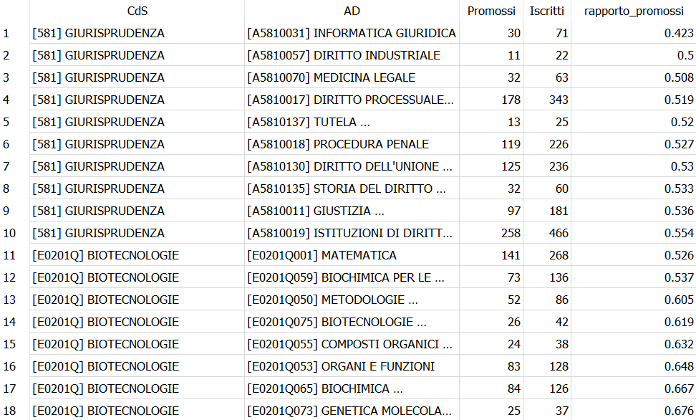
Query 2
Identification of the Top-10 most difficult exams, divided by field of study (the exam with the highest overall pass rate, considering all sessions of the Academic Year).
Output
The period examinated is from October 2016 to October 2017.
By isolating courses that feature a minimum of 10 didactic activities, we could reasonably compare diverse academic programs
Considering the overall pass rate for the teaching activities of “Giurisprudenza” seems that the most difficult exam is “Informatica Giuridica”, followed by “Diritto Industriale” and “Medicina Legale”.

Slide 7
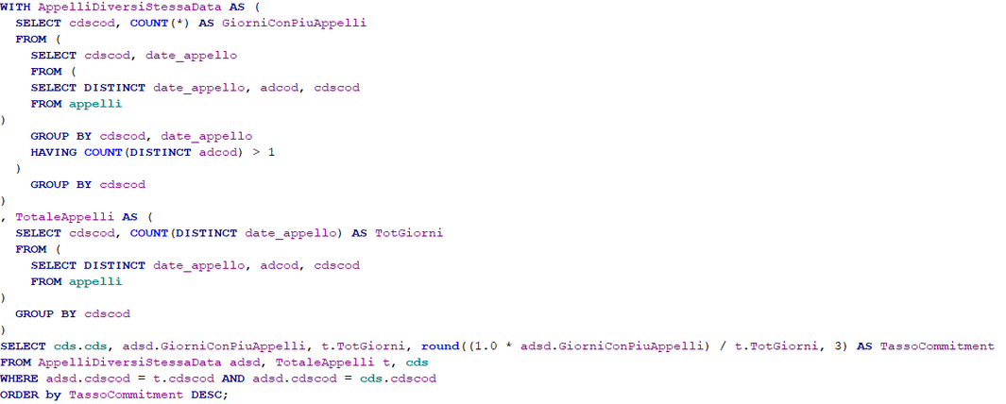
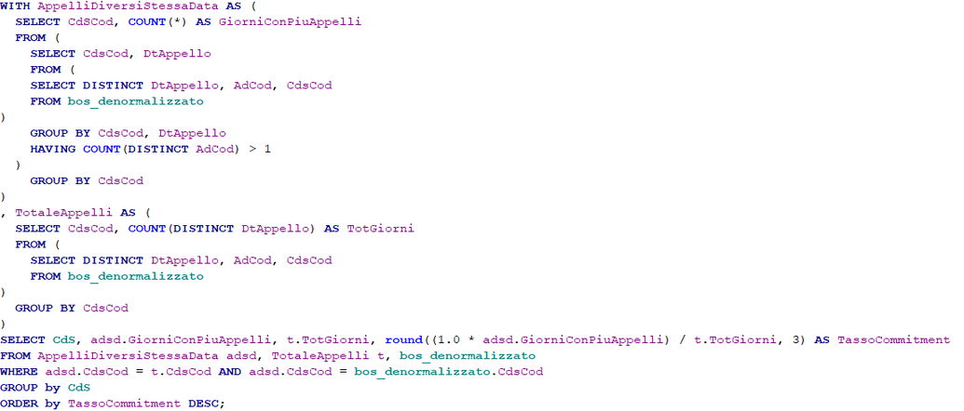
Query 3
Identification of degree programs with a high commitment rate, meaning different exam sessions of the same degree program that took place on the same day
Relational model
bos_denormalizzato
"AppelliDiversiStessaData" counts the number of days on which multiple distinct exams ('adcod') were held for the same degree program ('cdscod').
"TotaleAppelli" calculates the total number of distinct days on which exams were conducted for each degree program.
The final query merges this data to calculate the 'commitment rate'.

Slide 8
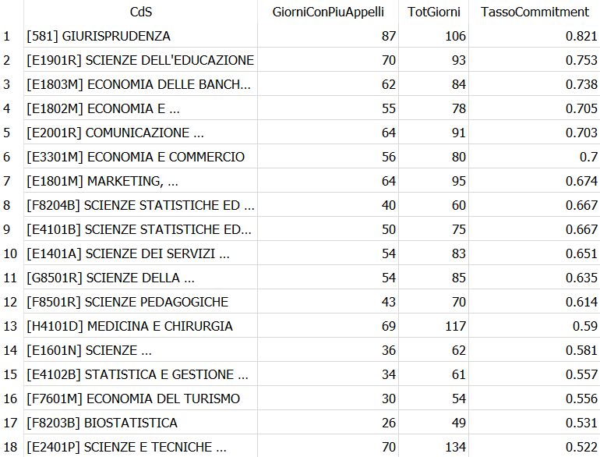
Query 3
Identification of degree programs with a high commitment rate, meaning different exam sessions of the same degree program that took place on the same day
Output
Considering all the course of studies, the ones which present highest commitment rates are “Giurisprudenza” with a value of 0.821 and “Scienze dell’Educazione” with 0.753;
On the other hand, the courses with the lowest commitment rates are “Psicologia clinica e neuropsicologia nel ciclo di vita” with 0.167 followed by “Scienze infermieristriche e ostetriche” with 0.182

Slide 9
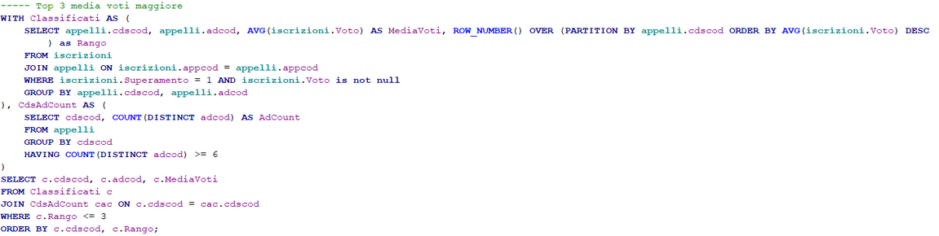
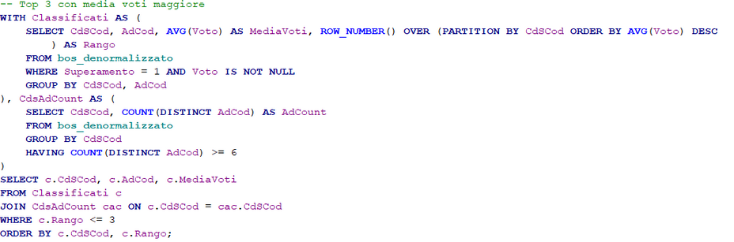
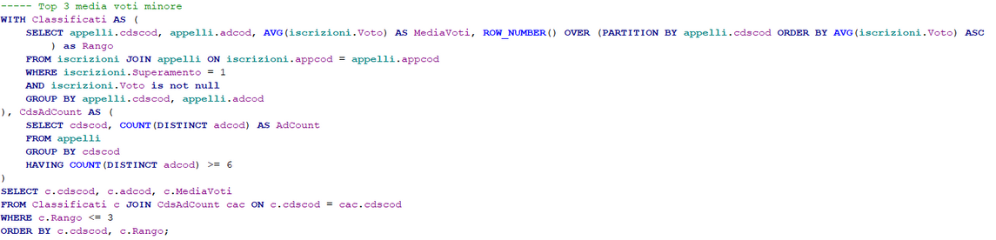

Query 4
Identification of the Top-3 exams with the highest and lowest average grades, respectively, calculated for each individual course of study
Relational model
bos_denormalizzato

Slide 10
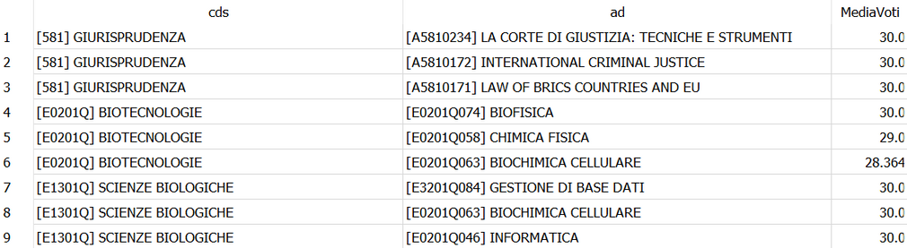
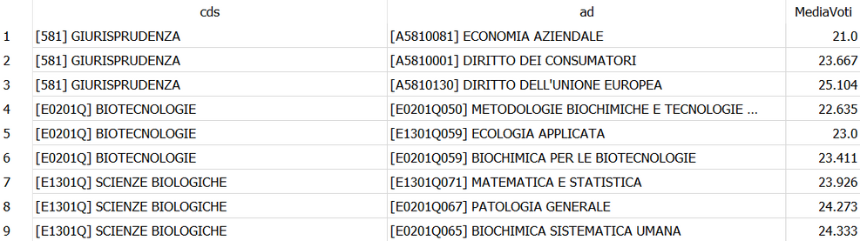
Query 4
Identification of the Top-3 exams with the highest and lowest average grades, respectively, calculated for each individual course of study
Output
We first calculated the average grade for each teaching activity within each degree program. The average is computed only for passed exams.
Then we counted the number of distinct teaching activities for each degree program and includes only those with at least 6 different activities.
The results are ordered by degree program and rank.
For example the three exams of Scienze Biologiche with the highest grades on average are “Gestione di Base Dati”, “Biochimica Cellulare” and “Informatica”.

Slide 11
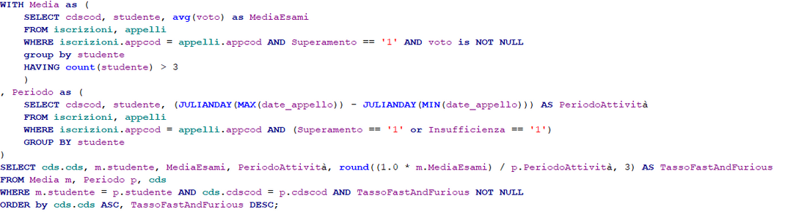
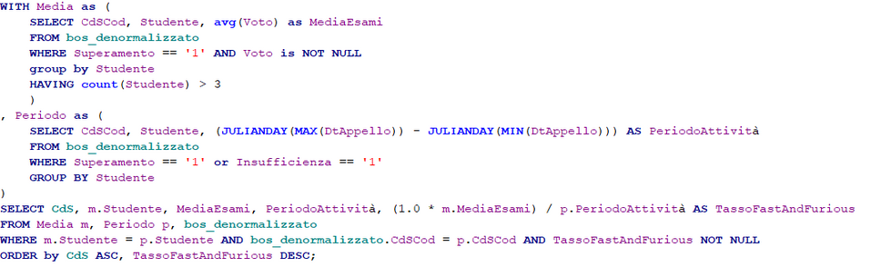
Query 5
Calculate the distribution of 'fast&furious' students by field of study, defined as students with the highest ratio of 'average grade achieved in passed exams' to 'period of academic activity'
Relational model
bos_denormalizzato
"Media" calculates the average exam grades of each student who has completed at least 4 exams, divided by course of study.
"Periodo" calculates the period of activity for each student., considering passed and failed exams
The final query merges this data to identify students with the highest Fast&Furious rate.

Slide 12
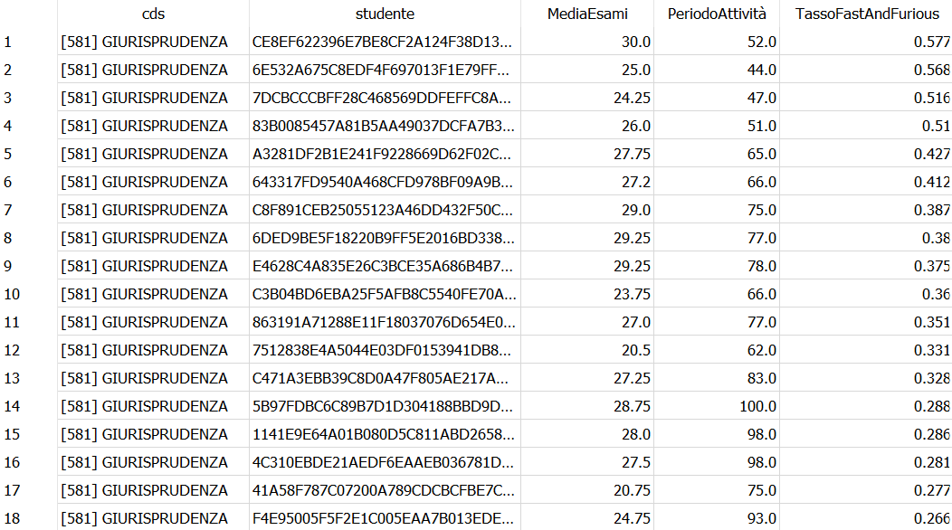
Query 5
Calculate the distribution of 'fast&furious' students by field of study, defined as students with the highest ratio of 'average grade achieved in passed exams' to 'period of academic activity'
Output
Filtering out students with less than 4 passed exams contributed to a more meaningful evaluation of the Periodo di Attività
The best students according to this ratio were from “International economics”, “Economia delle banche, delle assicurazioni e degli intermedi finanziari” and “Marketing, comunicazione aziendale e mercati globali” with values ​​respectively of 7.0, 5.875 and 3.531

Slide 13
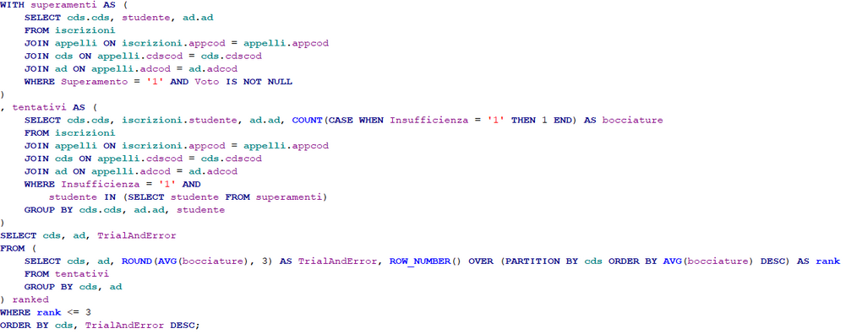
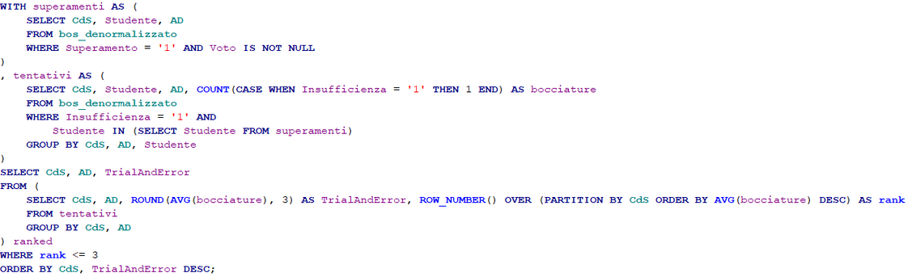
Query 6
Identification of the Top-3 'trial&error' exams, meaning exams that require the highest number of attempts before passing (average number of attempts (failures) by each student for each session of the course)
Relational model
bos_denormalizzato
"Superamenti" identifies students who have passed an exam for a specific educational activity in a course of study.
"Tentativi" counts the number of failures in each exam across various educational activities, only for the students in “Superamenti”.
The final query combines this data to identify exams with the highest Trial&Error rate.

Slide 14
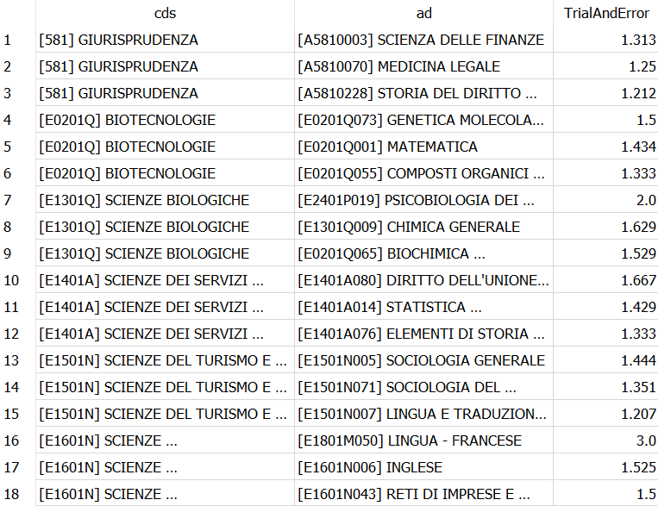
Query 6
Identification of the Top-3 'trial&error' exams, meaning exams that require the highest number of attempts before passing (average number of attempts (failures) by each student for each session of the course)
Output
The attemps considered only refers to “Insufficienze”
Across all the courses, the highest “trial&error” rate was found for “Lingua inglese” exam for “Tecniche di laboratorio biomedico” course with an average attempt of 3.2 before passing

Slide 15
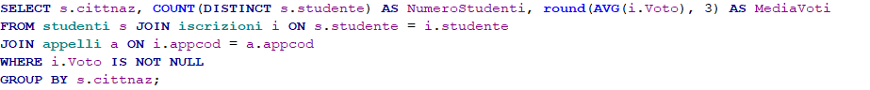
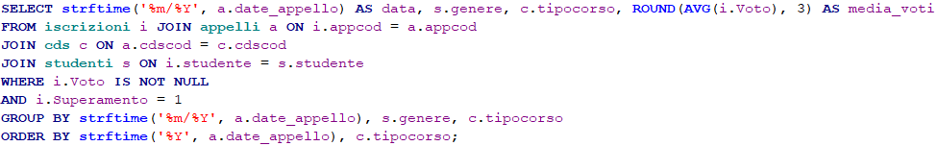
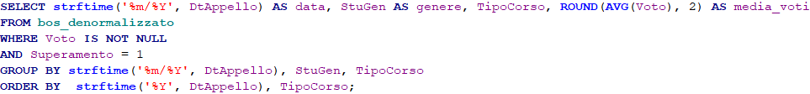
Query 7
Academic performance: geographical variation and gender disparities across study levels
Identification of the average grades based on the students' geographical origin
Comparison of average grades by gender across different levels of study programs, including 'Bachelor's', 'Master's', and 'Single-cycle Master's' degrees
Relational model
Relational model
bos_denormalizzato
bos_denormalizzato

Slide 16
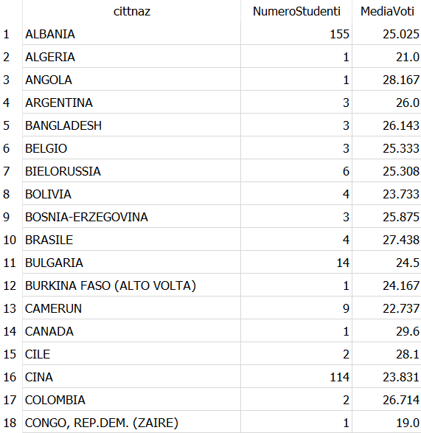
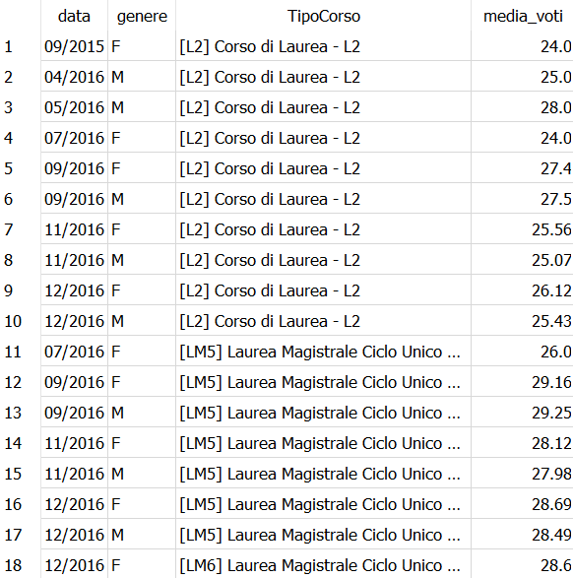
Query 7
Academic performance: geographical variation and gender disparities across study levels
Output
Identification of the average grades based on the students' geographical origin
Comparison of average grades by gender across different levels of study programs, including 'Bachelor's', 'Master's', and 'Single-cycle Master's' degrees

Slide 17
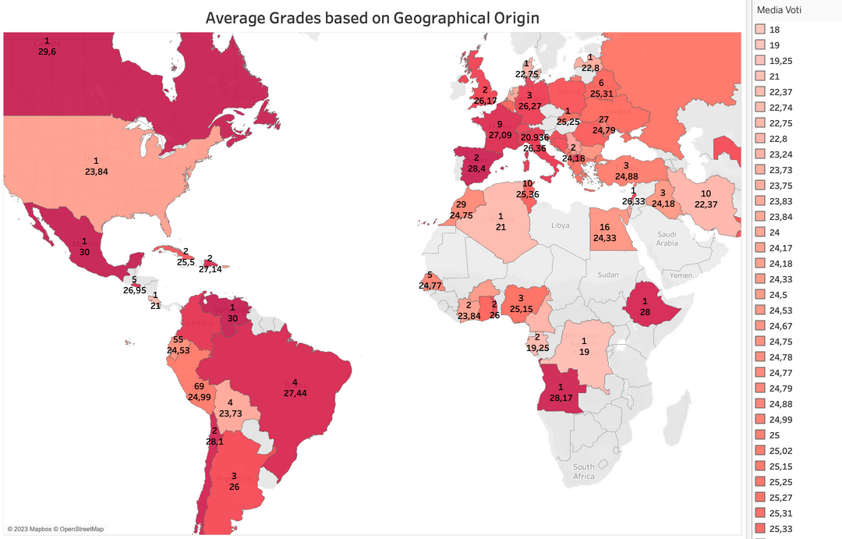
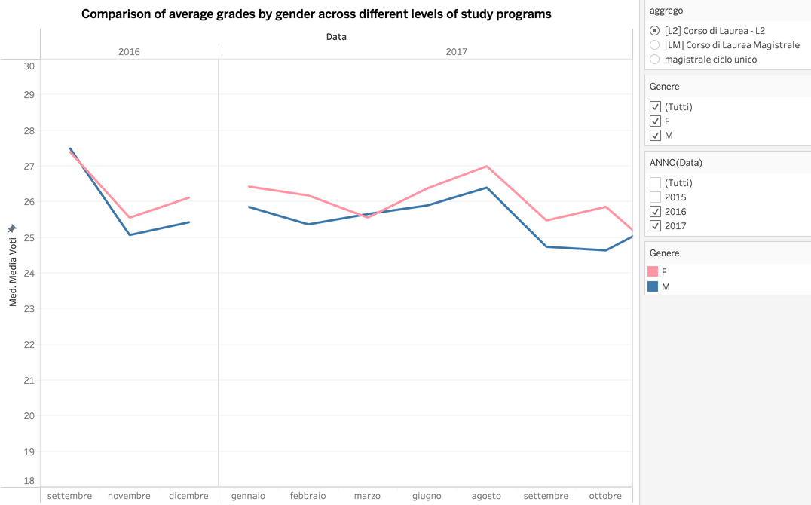
Query 7
Identification of the average grades based on the students' geographical origin
Comparison of average grades by gender across different levels of study programs, including 'Bachelor's', 'Master's', and 'Single-cycle Master's' degrees
Tableau: Query 7 Dashboard

Slide 18
Conclusion
Both queries (bos_denormalizzato and relational model) yield identical results, emphasizing the consistency of the database.
The bos_denormalizzato queries, though simpler to write, exhibits a relatively longer execution time.
The database contains an anomaly where sometimes a passed exam is associated with a null value under the “voto” attribute.

